Slide 1



Fatigue Detection For Operators In An Industrial Environment
Presented By:
Ali Al Hadi Ayache
19, 12, 2023

Slide 2
Contents
1
2
Problem Statements
Objectives
3
4
Background Materials
Methodology
5
6
Prove Threshold
Results
7
8
Conclusion
Future Works
02

Slide 3
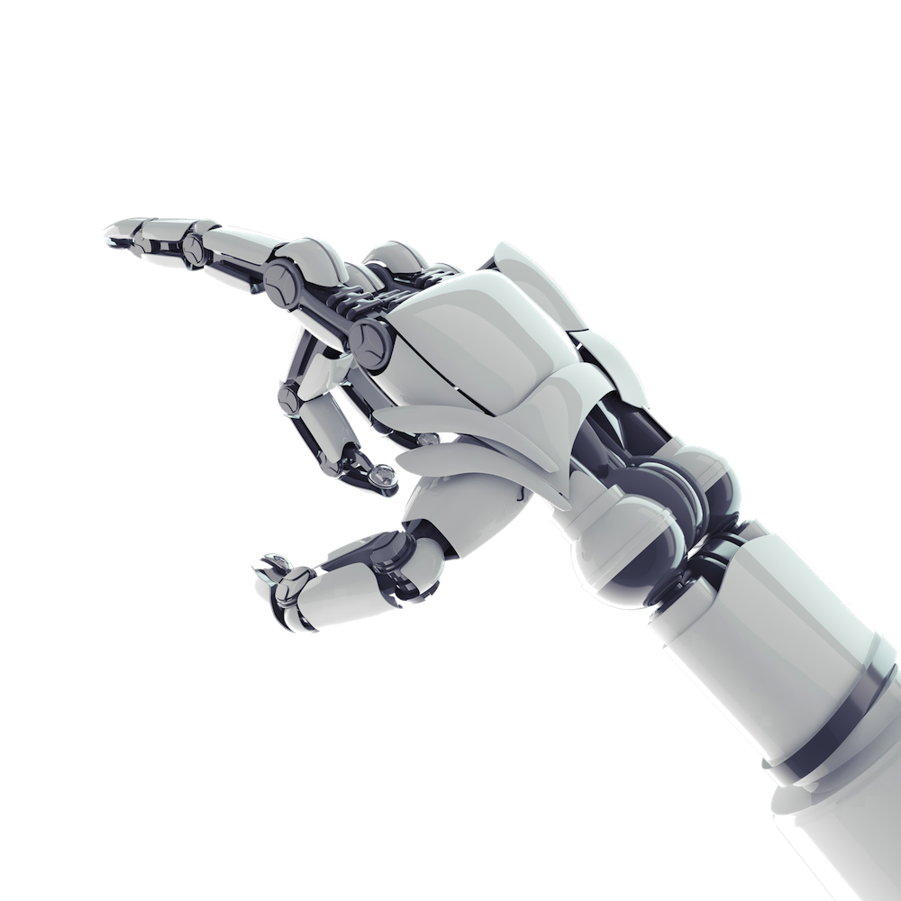
1
Problem Statement

Slide 4
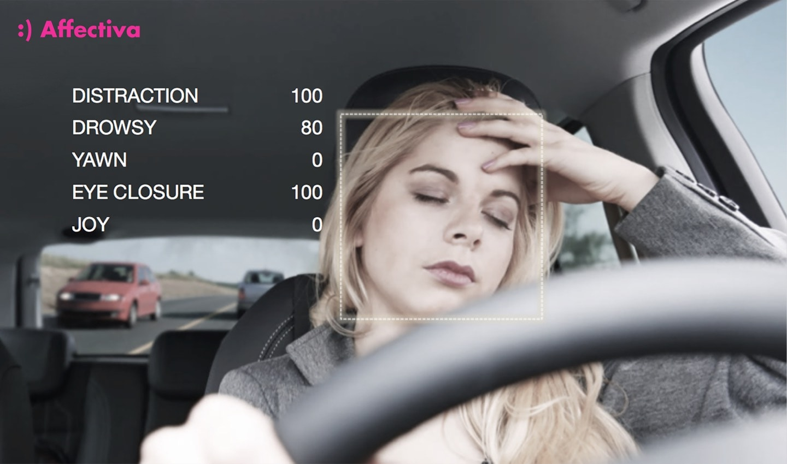
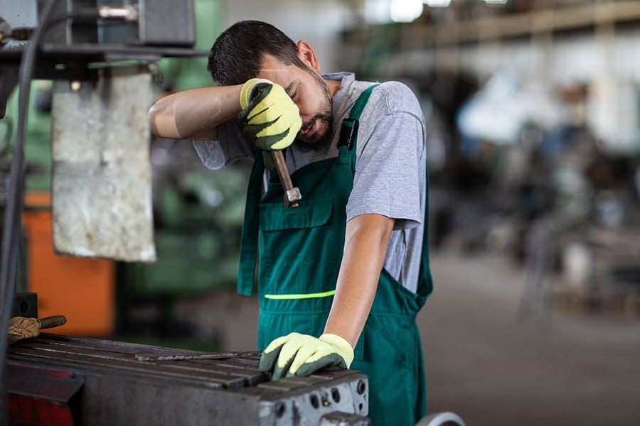
Problem Statement
Driver Drowsiness and Road Safety
Industrial Worker Fatigue and Workplace Safety
04
Notes:
Fatigue-related issues affect drivers, leading to accidents, injuries, and economic losses.
Fatigue-related incidents within industrial settings impact safety, productivity, and worker well-being.

Slide 5

2
Objectives

Slide 6

Objectives
Build a system for detecting fatigue signs by merging blinking and yawning with emotion detection.
02
Focus on fatigue detection based on facial expression recognition like eye blinks and yawning.
01
This system can detect 3 stages of fatigue.(mild-moderate-severe)
03
06

Slide 7
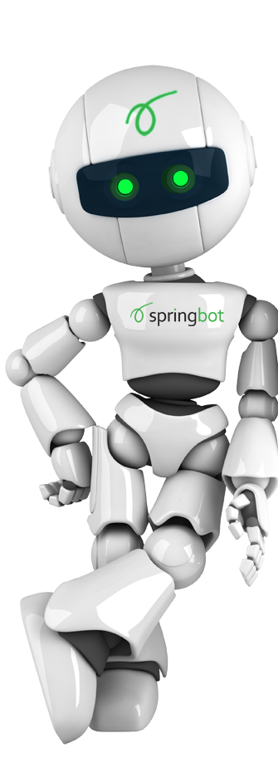
3
Background Materials

Slide 8
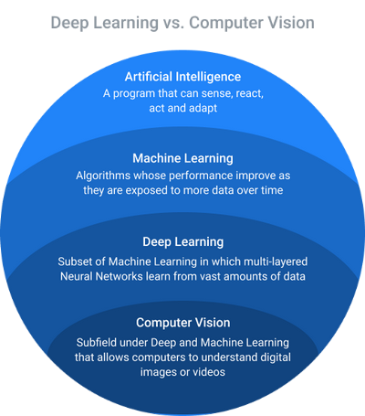






Background Materials
08
https://www.linkedin.com/pulse/%D9%83%D9%8A%D9%81-%D8%AA%D8%B1%D9%89-%D8%A7%D9%84%D8%A2%D9%84%D8%A9-computer-vision-mega-team-mu?originalSubdomain=ae

Slide 9
4
Methodology

Slide 10
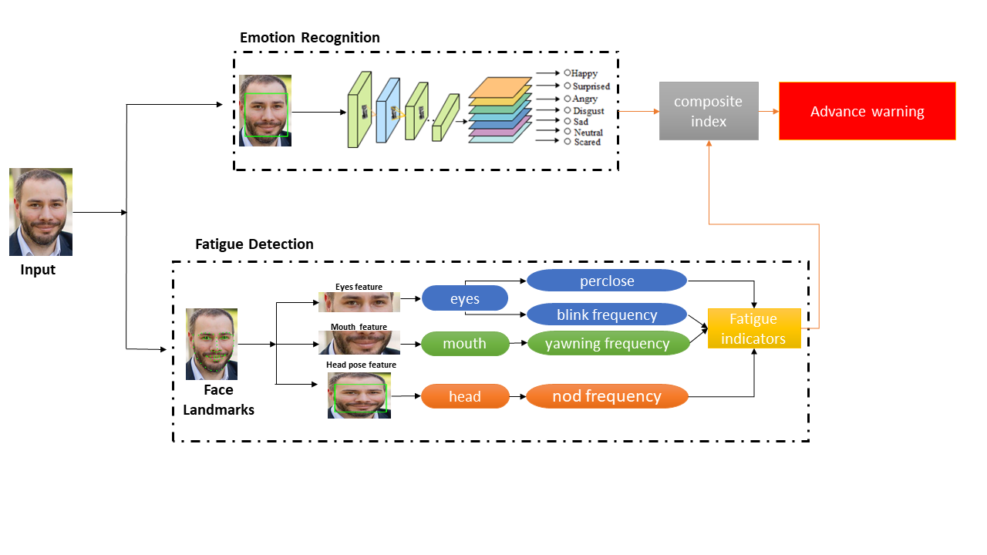
Methodology
10

Slide 11
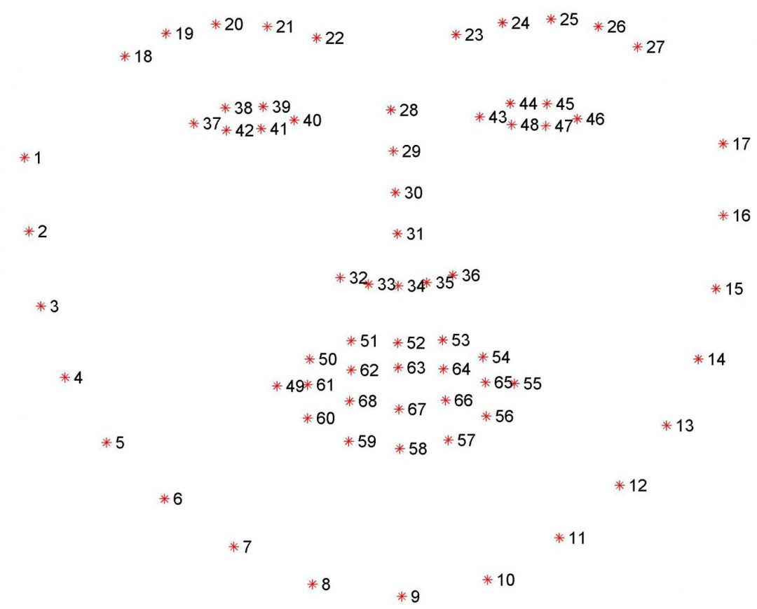
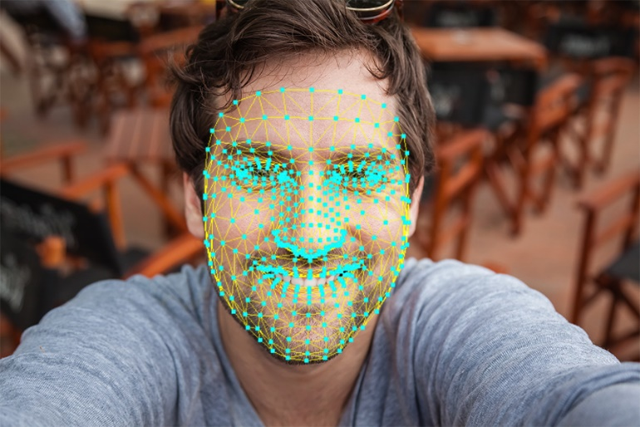
Face Landmarks
Dlib
Media pipe
https://www.analyticsvidhya.com/blog/2022/03/facial-landmarks-detection-using-mediapipe-library/
11
https://pyimagesearch.com/2017/04/03/facial-landmarks-dlib-opencv-python/

Slide 12
Methodology
10

Slide 13
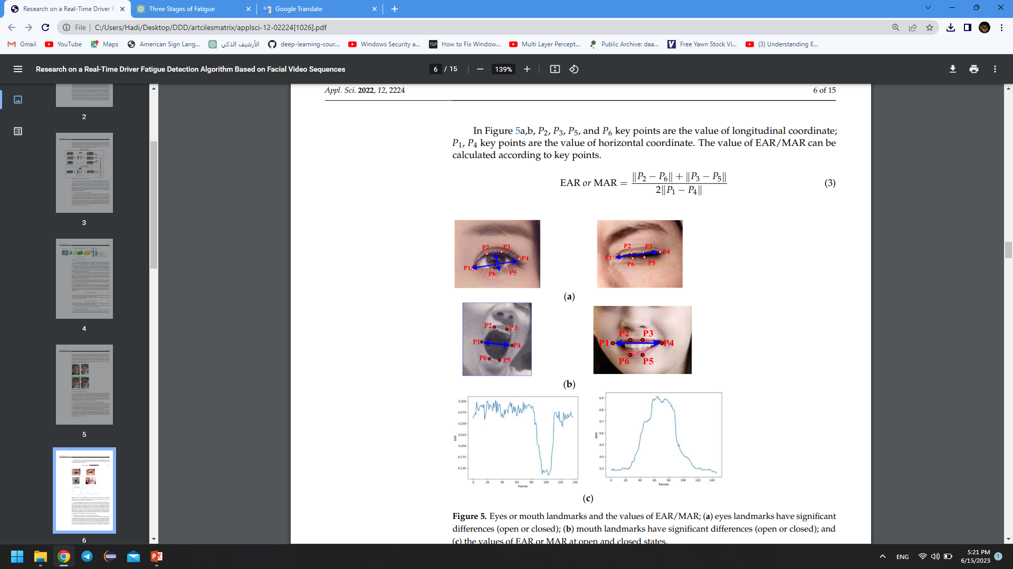
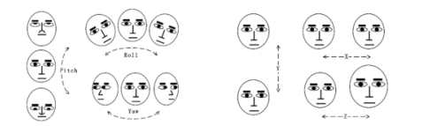
Eyes Mouth Head Indicators
EAR: Eyes Aspect Ratio
MAR: Mouth Aspect Ratio
38, 42, 39,41,37,40
Dlib
Media pipe
In 3D angles of head face ,need rotational matrix:
Extract all coordinates of face using media pipe
Put them in two array 2D and 3D
Calculate camera matrix using focal length
Calculate distortion matrix(facilitate math operation)
From these 4 parts we can calculate translation and rotation vector.
Change rotation vector to rotation matrix , then extract the angles
51, 59, 53,57,49,55
Driver Emotion and Fatigue State Detection Based on Time Series Fusion
12
Research on a Real-Time Driver Fatigue Detection Algorithm Based on Facial Video Sequences

Slide 14
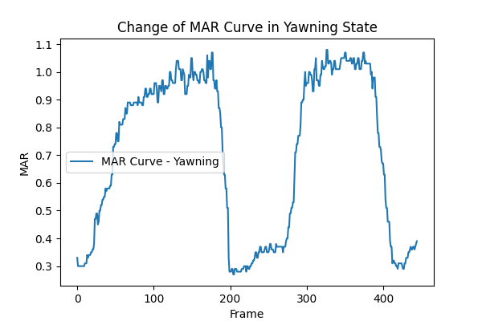
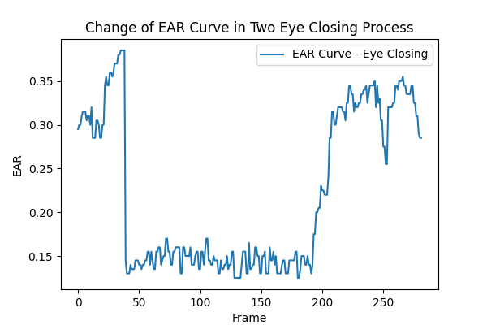
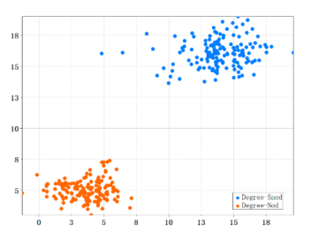
Eyes Mouth Head Indicators
Change of Head
Open Mouth
Drowsy
Closed Eyes
Normal
13

Slide 15
Methodology
10

Slide 16
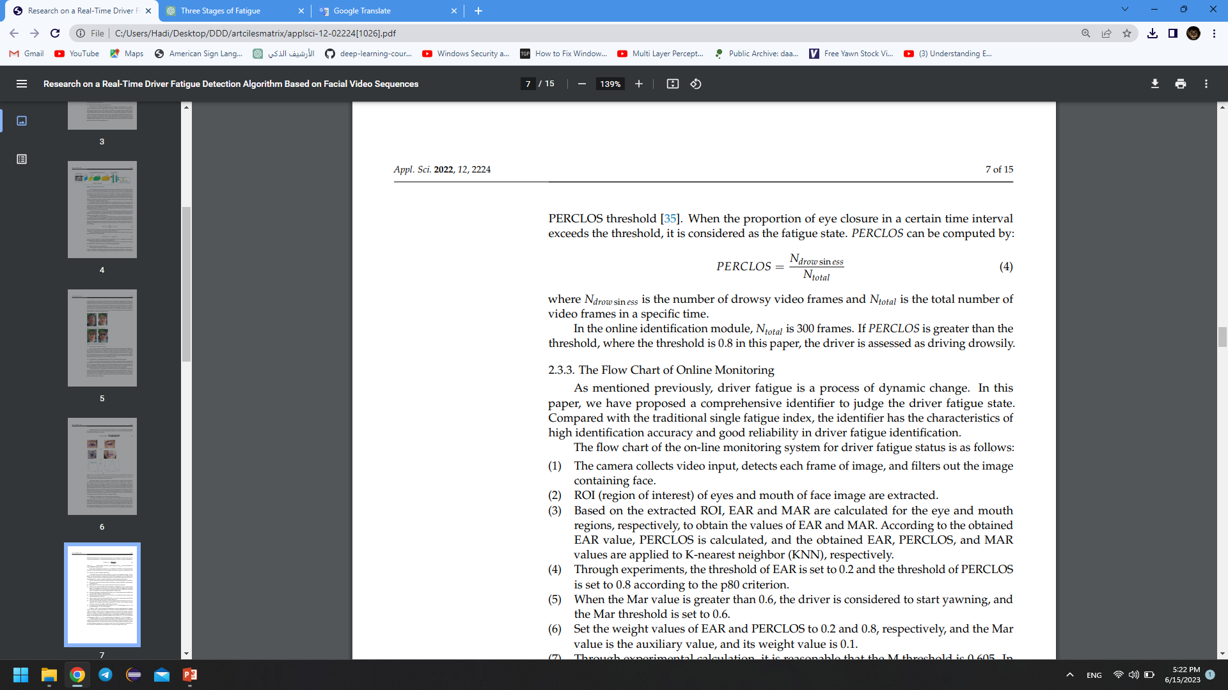
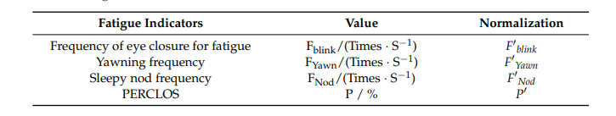
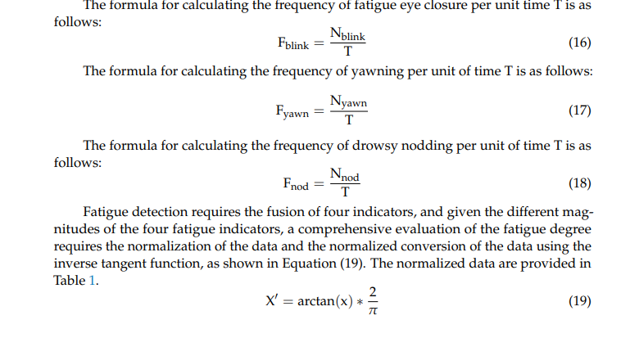
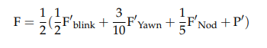
Eyes Mouth Head Indicators
The Ratio according to priority
N: number of state.
Ntotal: Number of all frames
T: Time per unit
X’:Normalized Function
F: fusion of four indicators
14
Driver Emotion and Fatigue State Detection Based on Time Series Fusion

Slide 17
Methodology
10

Slide 18
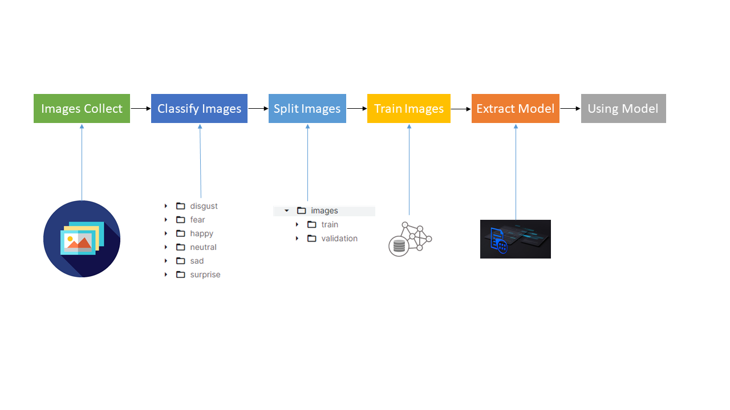
Emotion Recognition
15

Slide 19
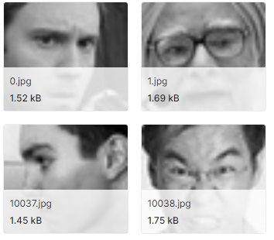
Images Collect
The dataset from Kaggle focused on seven distinct emotional states related to facial expressions.
This dataset comprises a total of 35,887 images.
16
https://www.kaggle.com/code/bankita058/facial-emotions/notebook

Slide 20
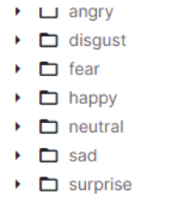
Classify Images
• Angry: 4,953 images
• Disgust: 547 images
• Fear: 5,121 images
• Happy: 8,989 images
• Neutral: 6,198 images
• Sad: 6,077 images
• Surprise: 4,002 images
17

Slide 21
Split Images
Divided the images into two sets: the training set and the validation set.
The purpose of this division is to train and test machine learning models effectively.
Split be 80% for train and 20% for validation.
18

Slide 22
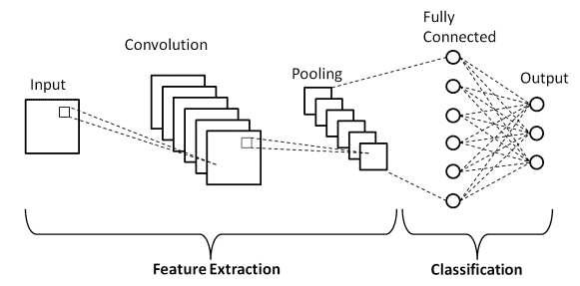
Train Images
convolution neural network
19

Slide 23
Extract Model
This step is crucial because it saves us from the need to retrain the model every time I want to use it, making the process more efficient and practical.
20

Slide 24
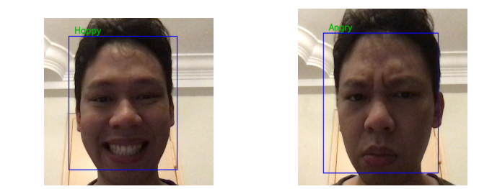
Using Model
Parameter | Value
Epochs | 100
Batch Size | 125
Accuracy | 72.61%
21
https://waiseekweng.wordpress.com/2020/03/27/real-time-face-emotion-detection-using-deep-learning/

Slide 25
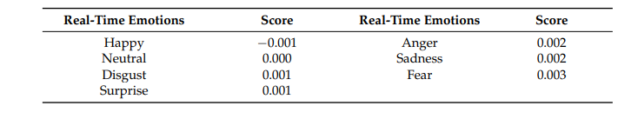
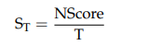
Fatigue Indicators By Emotion
N: number of state.
T: Time per unit
Score: from table
22
Driver Emotion and Fatigue State Detection Based on Time Series Fusion

Slide 26
Methodology
10

Slide 27
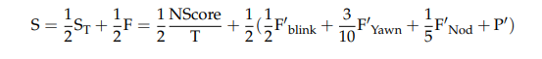
Composite Index
The status of the fatigue is divided into four levels according to the score: normal, mild fatigue, moderate fatigue, and severe fatigue, as indicated in T.
23
Driver Emotion and Fatigue State Detection Based on Time Series Fusion

Slide 28
5
Prove Threshold

Slide 29
Prove Threshold
Dataset consisting of videos recorded in close succession
The videos has a duration of 30 minutes
Features individuals using laptop or desktop PCs
First 10 minutes of each video when the individuals are in a normal state
Last 10 minutes when they start to exhibit signs of fatigue
Divide these 10-minute segments into 1-minute intervals
http://www.drozy.ulg.ac.be/
25

Slide 30
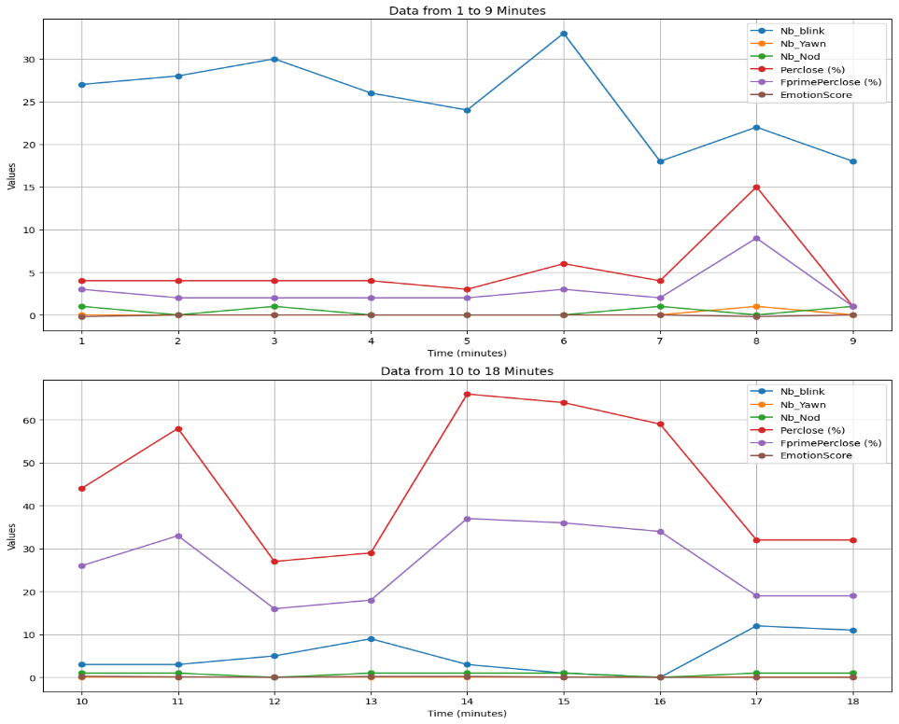
Prove Threshold
26

Slide 31
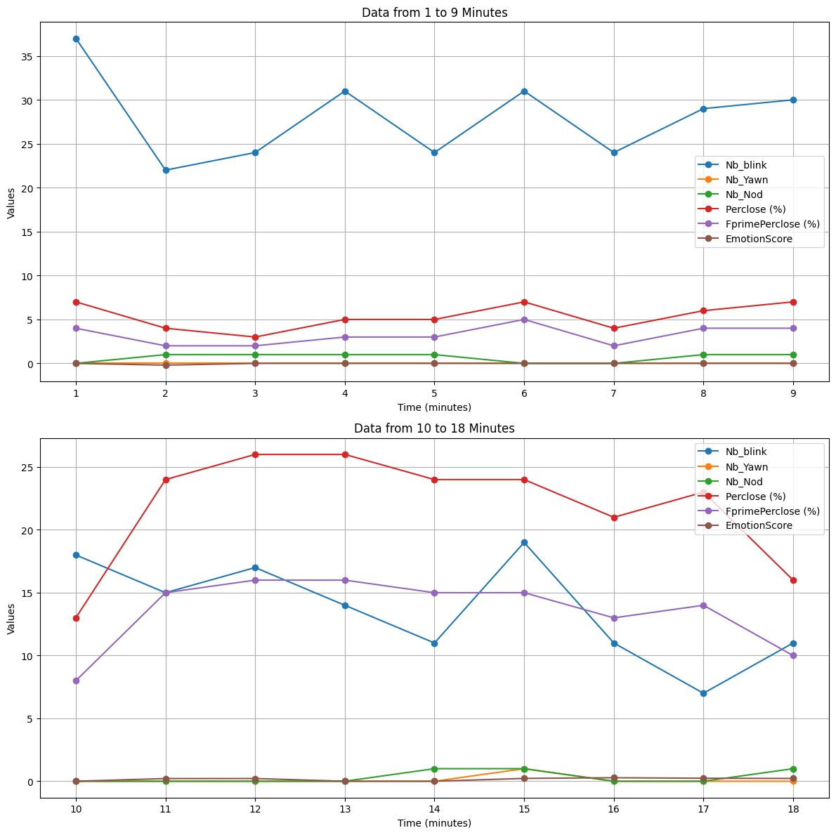
Prove Threshold
27

Slide 32
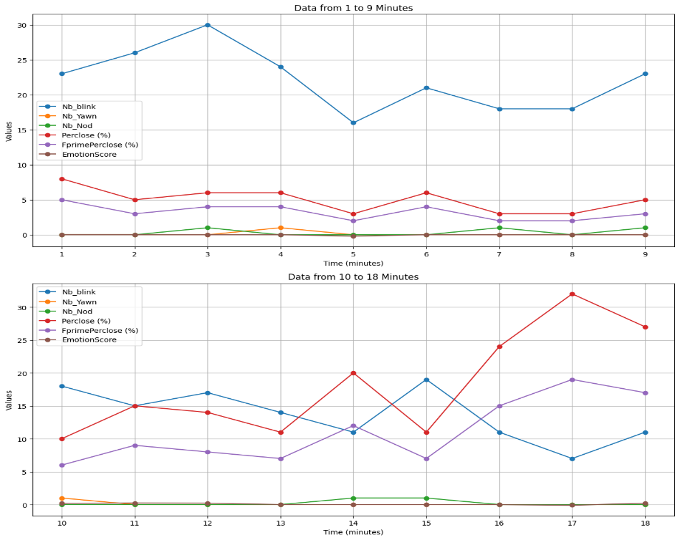
Prove Threshold
28

Slide 33
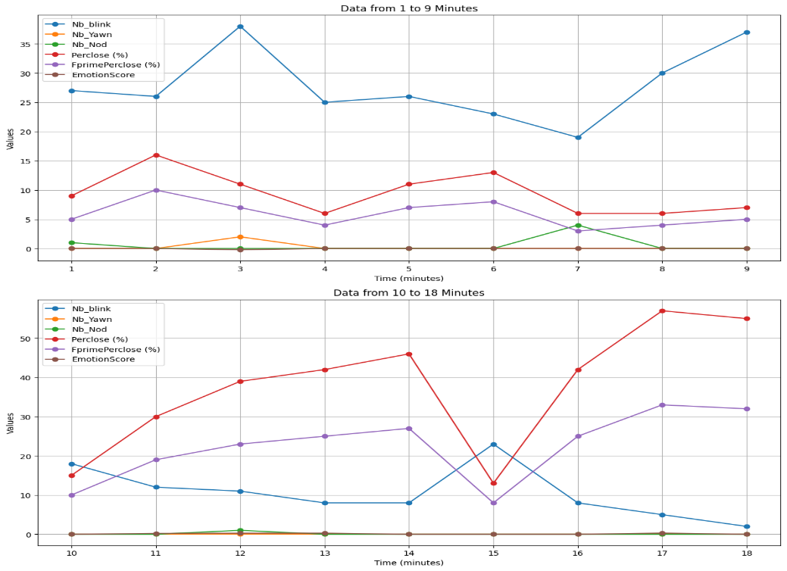
Prove Threshold
29

Slide 34
6
Results

Slide 35
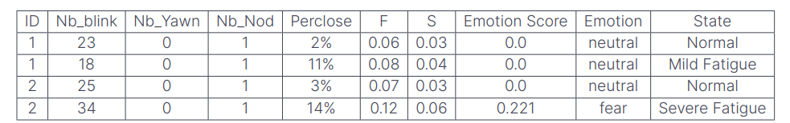
Results
After taking the average between the four persons for the first 10 min at minute 3 and for last 10 minute at minute 17, I observe this threshold according to the value of S.
Then I test 2 other persons and see the results in table.
Normal | Fatigue
S<=0.3 | S>=0.4
30

Slide 36
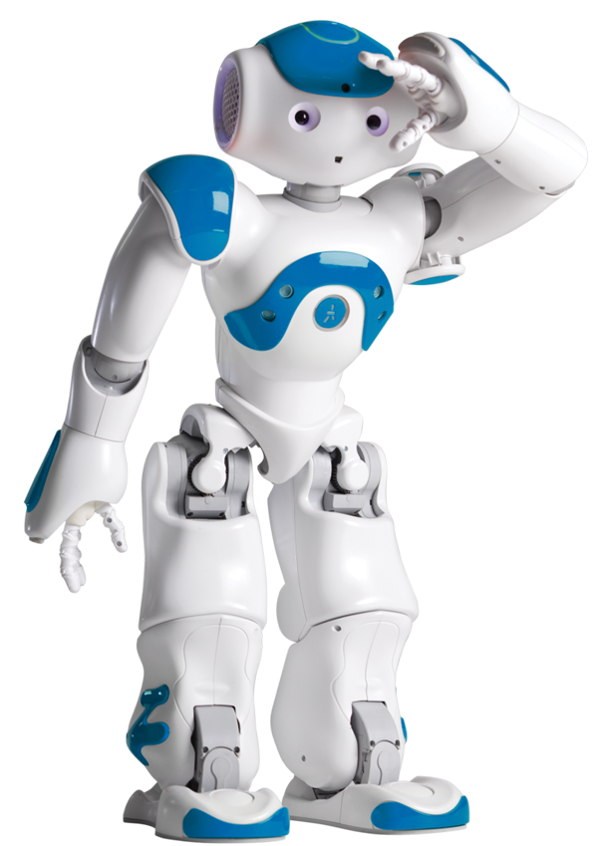
7
Conclusion

Slide 37



Conclusion
Combines image processing techniques and Convolutional Neural Networks (CNNs).
Establishment of a strong technical foundation by exploring principles in artificial intelligence, computer vision, machine learning, and deep learning.
multi-pronged approach to create a resilient fatigue detection system, including eye states, blink frequencies, head posture, and yawning detection.
31

Slide 38
8
Future Works

Slide 39


Future Works
Using deep learning models in all system.( (CUDA) for training ),best accuracy.
Collect huge data in different ways in the car or industrial environment and making tests for best accuracy.
32

Slide 40

Thank you

